Slide 1
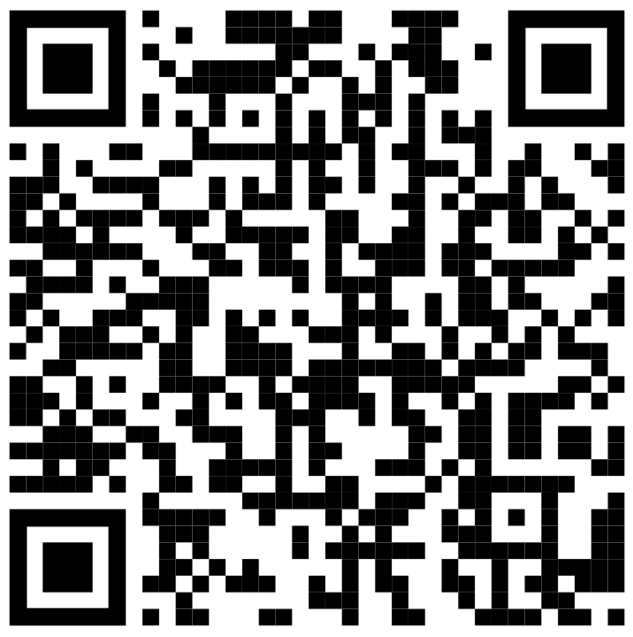
T-SQL - Beyond the Basics
https://github.com/BarneyLawrence
/Sessions-TSQL-BeyondTheBasics
Barney Lawrence
@SQLBarney

Slide 2












PLATINUM
GOLD
@DataRelay_UK
#DataRelay
DataRelay.co.uk
Thank you to our sponsors. We couldn’t do it without you!
BRONZE

Slide 3






About Me

Slide 4
Why?

Slide 5
Content
SSMS Tips and Tricks
Common Table Expressions
Apply Operator
Window Functions
Pivoting
Unpivoting
Putting It All Together

Slide 6
SSMS - Options

Slide 7
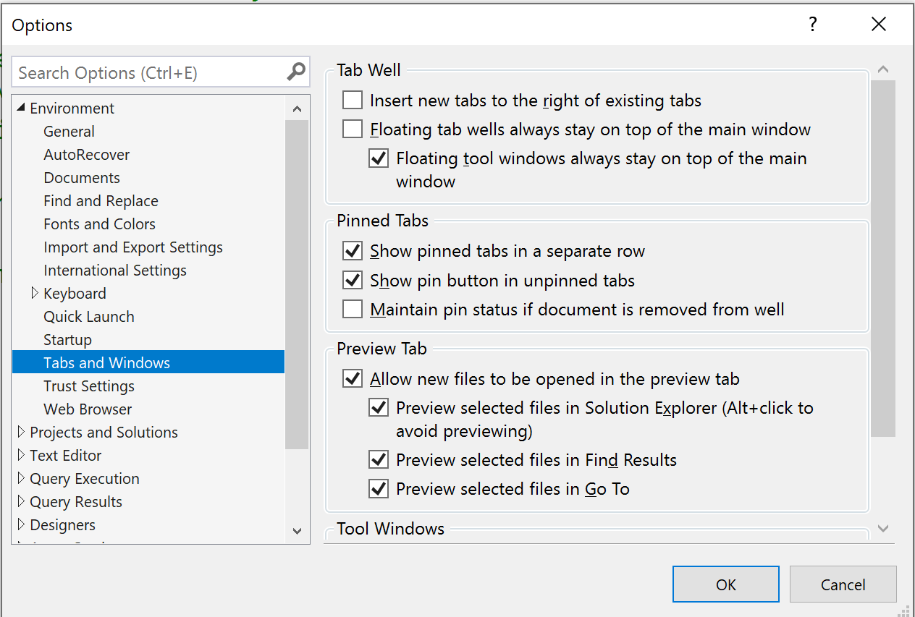

Slide 8
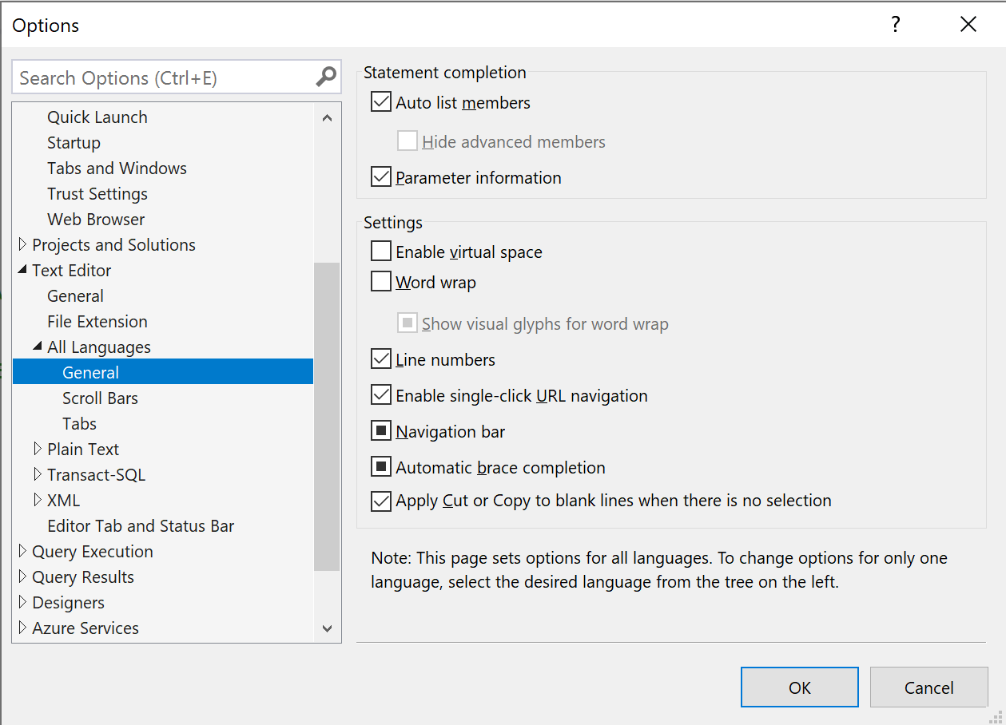

Slide 9
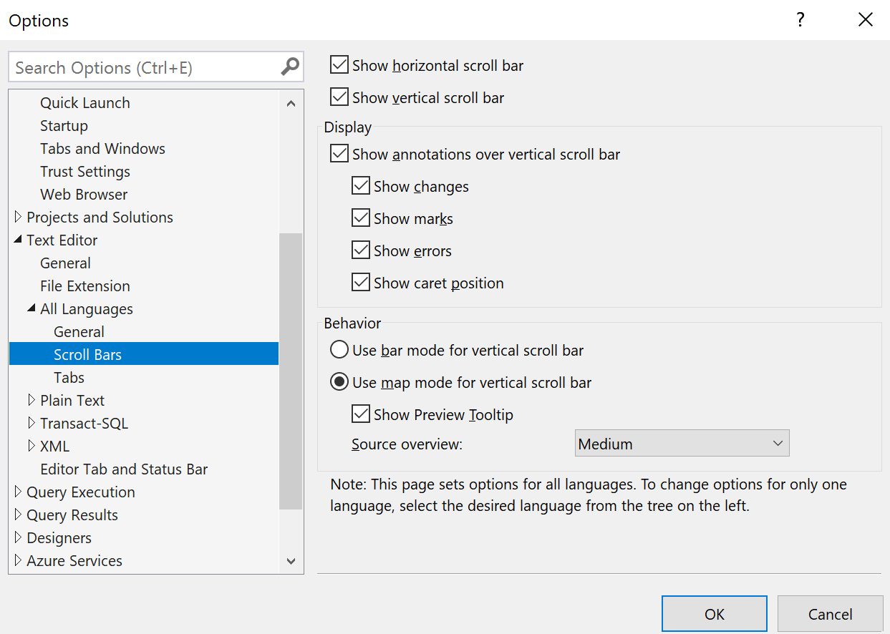

Slide 10
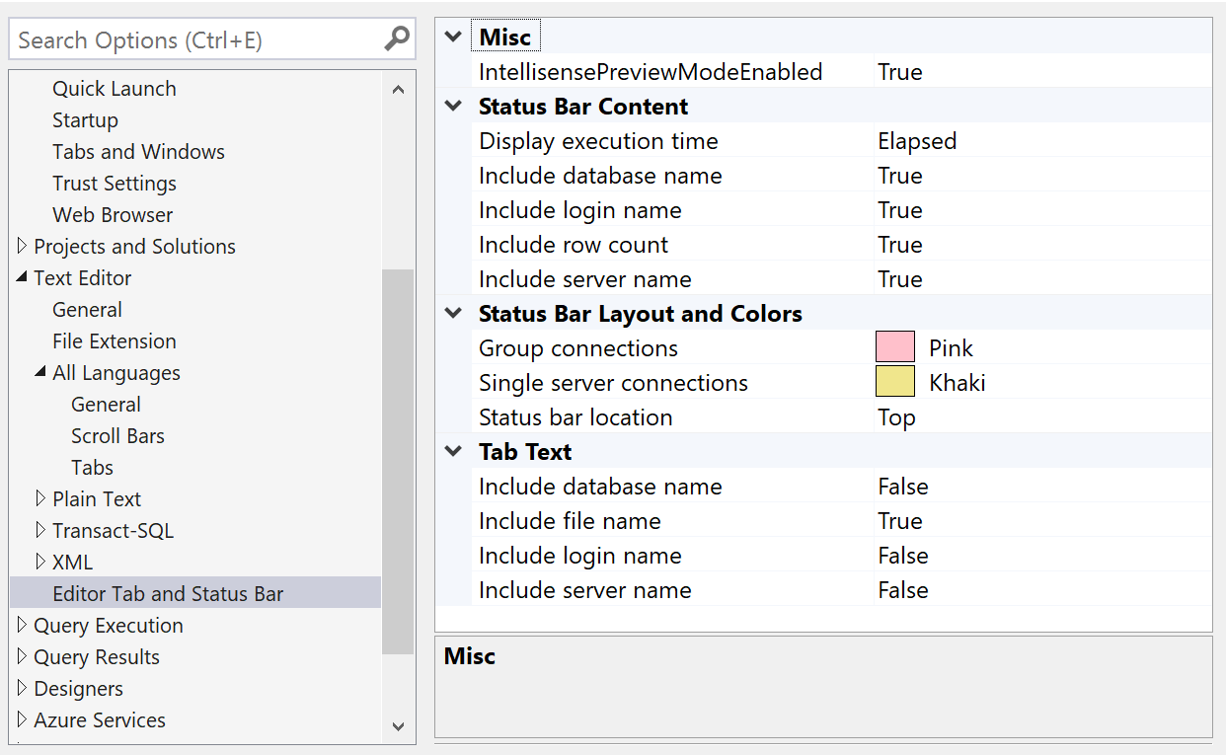

Slide 11
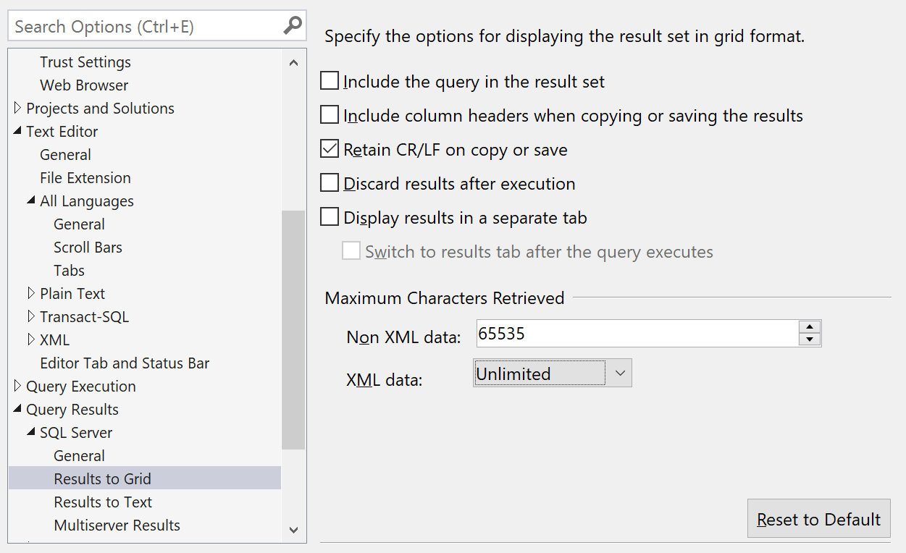

Slide 12
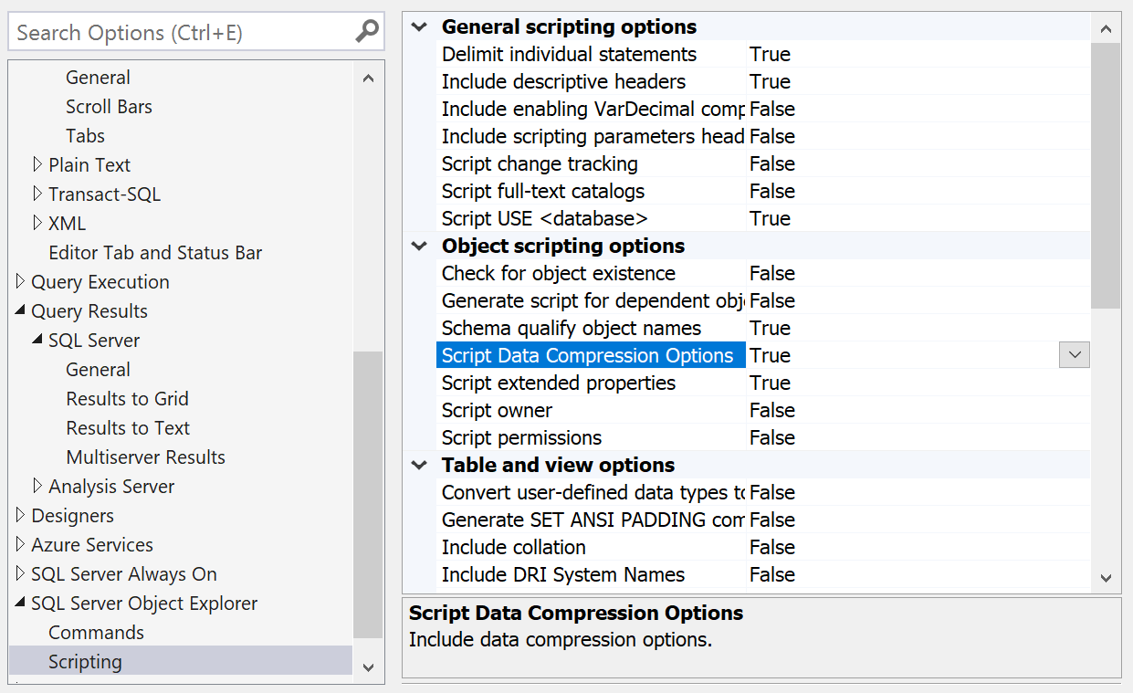

Slide 13
SSMS - Custom Keyboard Shortcuts

Slide 14
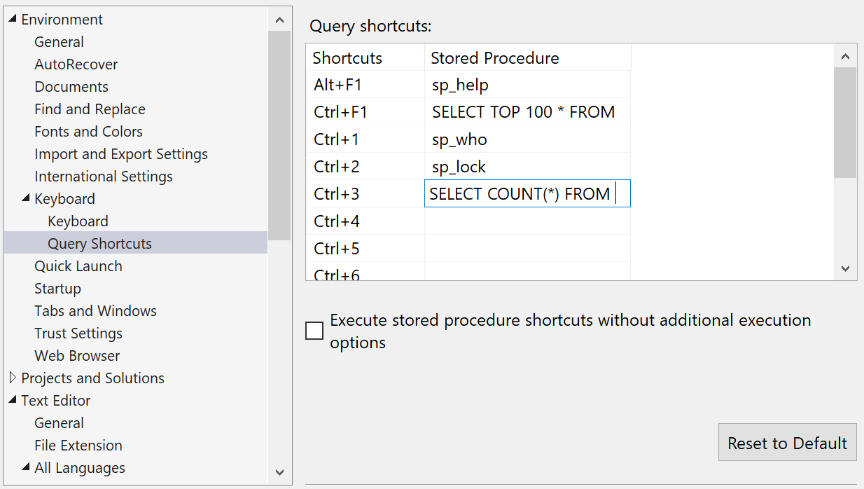

Slide 15
SSMS – Alt Key

Slide 16
T-SQL - Beyond the Basics
https://github.com/BarneyLawrence
/Sessions-TSQL-BeyondTheBasics
Barney Lawrence
@SQLBarney

Slide 17
PLATINUM
Feedback
GOLD
https://datarelay.co.uk/Feedback
BRONZE
@DataRelay_UK
#DataRelay
DataRelay.co.uk

